Slide 1
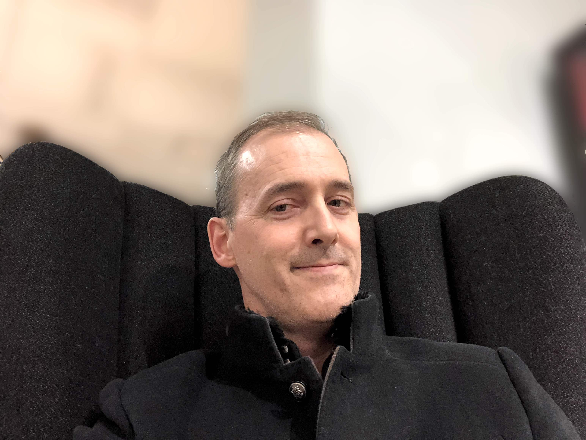
Lance Kind
Lives in Texas (formerly of China, India, and Seattle)
Agile Developer since 1999
Agile Consultant since 2006
Helping clients with BDD since 2010
Likes to take selfies in cool chairs
Author of science fiction and Agile business novels (pen name: Lancer Kind)
Host/producer podcasts: Agile Thoughts, SciFi Thoughts, and 敏捷理念.

